Slide 1

Team IC-U Intelligent Detection and Deterrence
Nick Bosler
Tim Florencki
Odaro Omusi
Matt Wohlwend

Slide 2
Problem Description
Security systems use many different inputs to alert the owners, but can do very little as far as actively deterring intruders and determining their identities. Also, many systems use low quality video cameras to capture movement but cannot capture descriptive features of the intruder. This project seeks to create a system that can both act as a physical deterrent and capture hi-resolution images of the intruder.

Slide 3
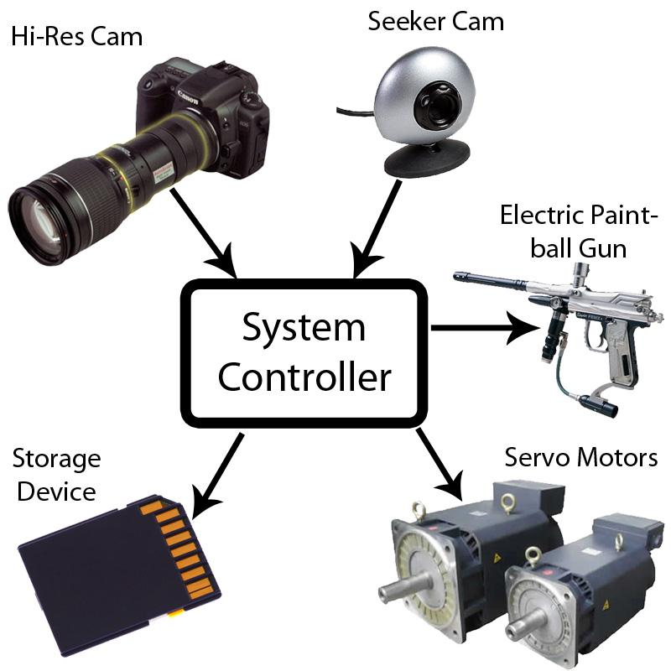
Proposed Solution

Slide 4
Demonstrated Features
We would like to implement the following features in our final design:
Accurate motion sensing algorithm
VGA video
Motion of gun/hi-res camera tied to location of detected motion from incoming video feed.
Automated trigger control of the gun
SD card for images
Ability to toggle the use of high resolution image capture and paintball gun fire.

Slide 5
Available Technologies
Inexpensive webcam to act as the seeker cam for actual motion capture (~15$)
Higher resolution camera to capture image of intruder (<$50)
Electronic-control paintball gun (already available from a teammate)
Two actuators (servo motors) for motion in two axes (~ $10 each)
Servo controller with interface to system microcontroller

Slide 6
Available Technologies
Motion-tracking algorithms (such as blob tracking for tracking dynamically changing objects)
Digital signal processor for image processing and/or A/D conversion
External SD card for storing images from high-resolution camera
Overall system microcontroller with state controls that direct the actions of all the other features

Slide 7
Block Diagram

Slide 8
Engineering Content
Motion Tracking Software Algorithm
We need an algorithm sophisticated enough to address the following:
Moving objects may not have constant velocity.
Most environments are not static.
Vibrations from the firing gun affect motion tracking
Wide field of view leads to barrel distortion

Slide 9
Engineering Content
Video processor
System will require intensive video processing above what the system microcontroller can perform while controlling all the other parts of the system.This will require an RS232 (serial) or USB interface to the microcontroller.
Servo design and control
The servos will use an RS232 interface to communicate with the system controller through a servo controller/relay.

Slide 10
Engineering Content
Data Storage
The high-resolution pictures and seeker cam video must be stored. We will use an SD card and card interface to achieve this goal.
Electric Gun
This will be wired directly or indirectly via a relay to the system microcontroller depending on the voltage and current requirements that the switch requires.

Slide 11
Engineering Content
High Resolution and Seeker Camera
The stationary seeker camera will send a video feed to the video processor to be analyzed for movement. This interface depends on the video processor.
The controller must be able to tell the high-res camera to take a picture via the interface available. This image must also be sent to the microcontroller for storage in the SD card via a USB interface.
Power
The servo controller, cameras, electric gun and microcontroller all need independent power supplies.

Slide 12
Conclusions and Challenges
Through the use of existing technologies Team IC-U hopes to integrate two useful security features into one system. Integrating the paintball gun allows a security system to fight back against intruders and actively deter crimes from occurring. Using the high resolution camera to identify intruders the system also helps in the prosecution of the intruder. This system increases safety for its users and their household or business.
The key challenges of this system are the motion sensing algorithm, high-res image storage and capture, and communication between each system. Correctly implementing the overall system processor will be the most important part. While these challenges are significant, Team IC-U feels that the rewards are certainly worth it.

