Slide 1
Ninja TurtlEEs
Bowman Creek Robot Inspection
Casey Morris, John O’Brien, Josh Vahala, Justin Yoder

Slide 2
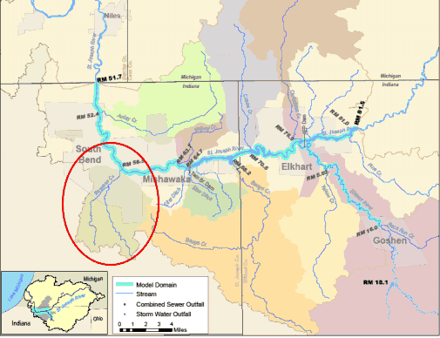
Introduction
Bowman Creek Tributary

Slide 3
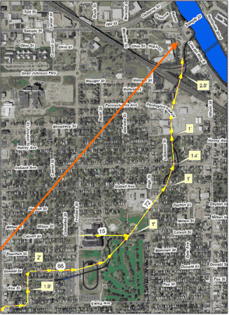
Environmental Problem
Aquatic Life
Dumping
Disjoint Pipes
Sewage Treatment

Slide 4
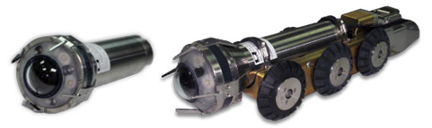
Problem Statement
Movement of current robot in large sewer pipes
Stationary camera
Base of robot if altered with attachment arm

Slide 5
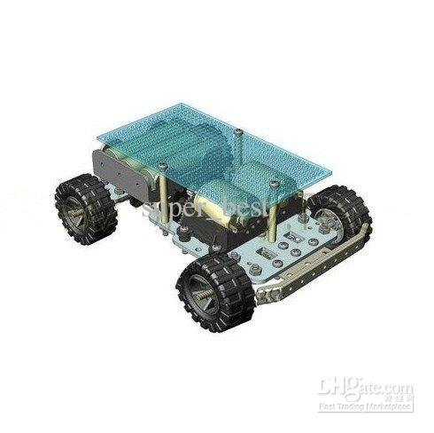
Solution
Chassis with wheels
Mounted Camera
Autonomous and Human Controlled
Gyroscope and Sonar Sensor

Slide 6
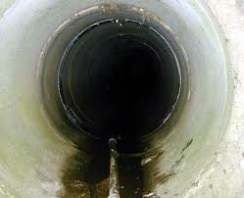
Demonstration
Video
  Both modes
  Show off success
In-Class
  Show off control system

Slide 7

Robot Housing
Needs a water resistant casing

Slide 8
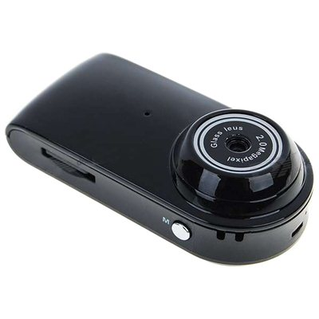
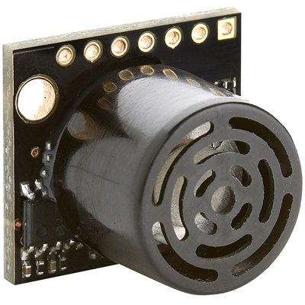
Camera
Sonar
Simple videocamera
Detecting proximity to walls

Slide 9

User Interface
LCD screen is for viewing the video feed from the robot
A touch screen could also be used to control the robot and the camera

Slide 10
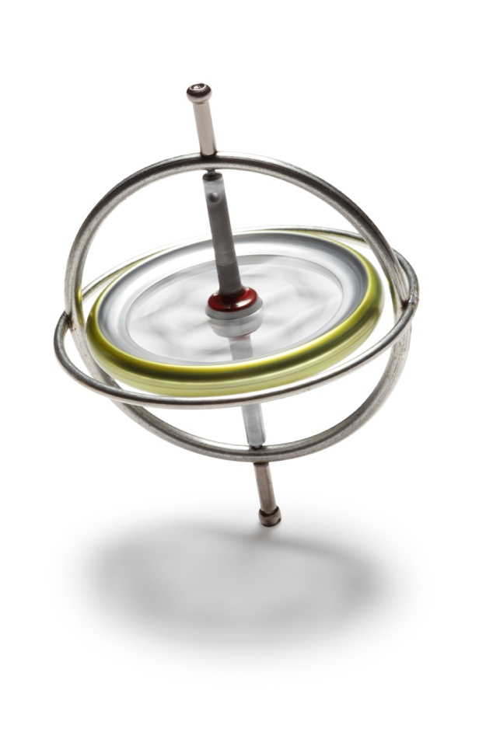
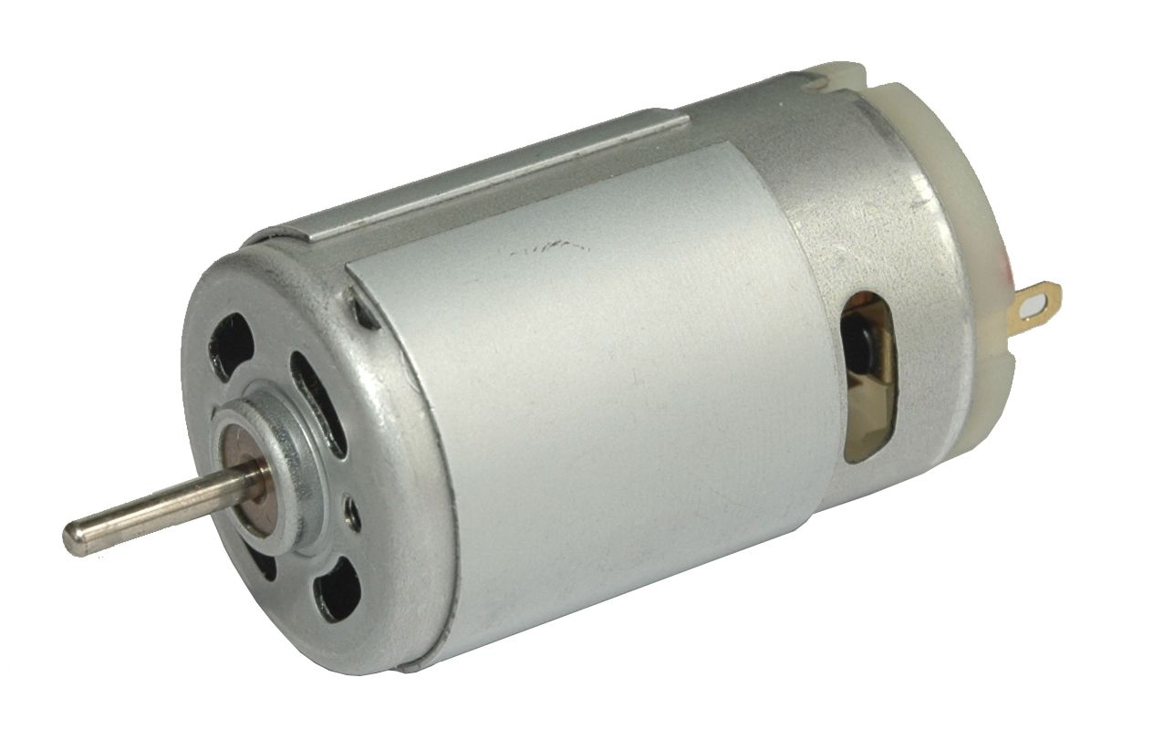
Motors
Gyroscope
4 standard motors and pulse width modulators to drive the wheels.
A servo will control the camera.
Detects angle of robot
Actual gyroscopes are very small

Slide 11
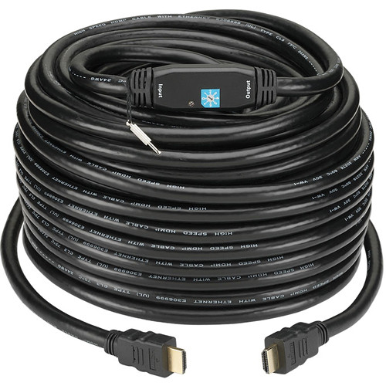
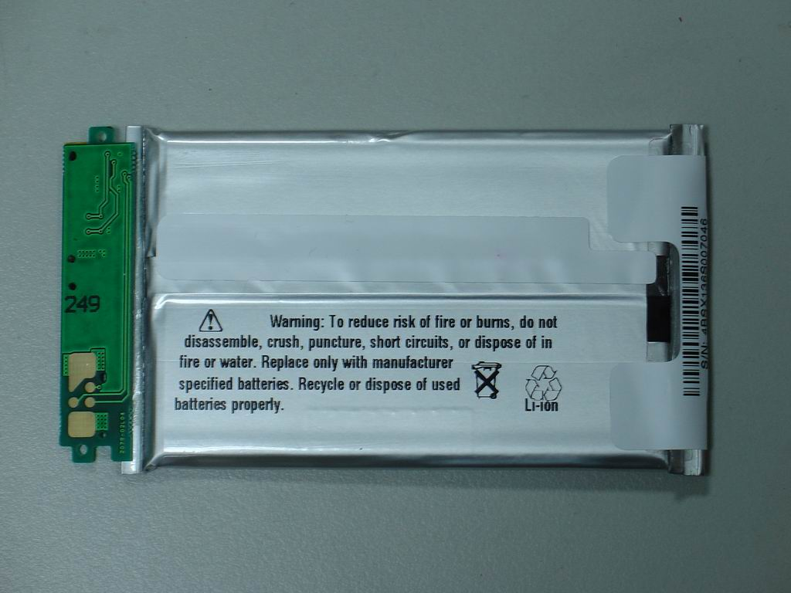
Video
Battery
Video cable transmits back to user
Wireless video transmitters are expensive
Powered by either a battery or a power cord

Slide 12
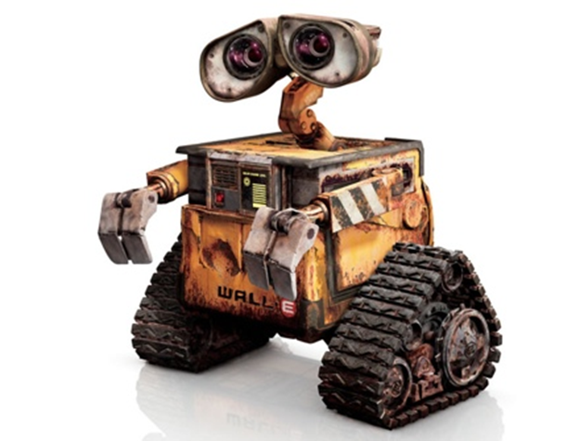
Engineering Content
Robotics
Control
  Making it wireless?
Environment Sensing
  Stay upright, avoid walls, detect leaks and obstacles
Automation
  Problem spot detection, map marking, auto return

Slide 13


