Slide 1
Blood Glucose Monitor
Our Team:
EE: Chris Homa, Matt Henne, Mike Williams
ME: Ish Amagashie
CS: Sofyan Saputra

Slide 2
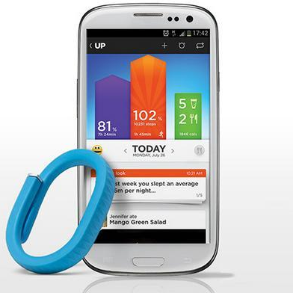
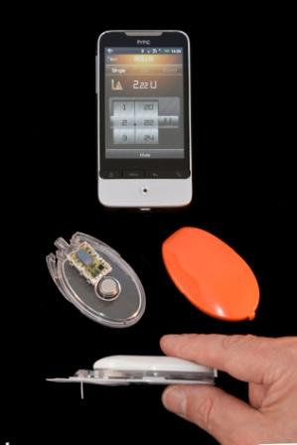
Introduction
We want to bring blood glucose monitoring to the 21st century!

Slide 3

Problem Description
When was the last time I checked my blood sugar?
Did I remember everything?
Where is my glucometer?
Why do I not feel good?
Where are my test strips?
Where is my lancing device?

Slide 4
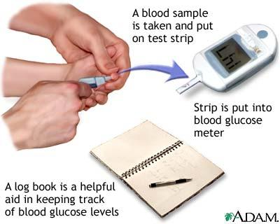
Problem Description

Slide 5
Problem Description
Why is this so hard?

Slide 6
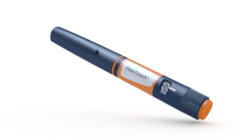
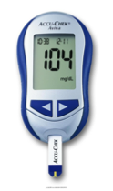
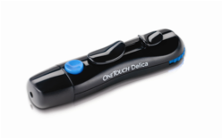
Proposed Solution
All-in-one device
  Glucometer
  Lancing Device
  Test Strip Cartridge
  Insulin Pen
Web App

Slide 7
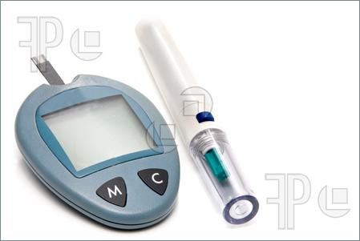
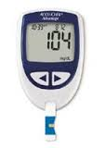
Demonstrated Features
· Hold a standard size cartridge of test strips
· Provide a lancing device
· A slot to insert the test strip into the glucometer.
· A microcontroller with analog to digital converter to generate a blood sugar reading.
· A microcontroller that can calibrate to multiple test strips

Slide 8
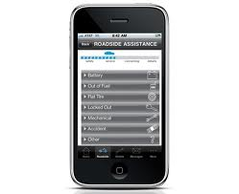
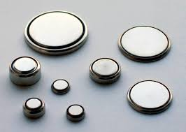
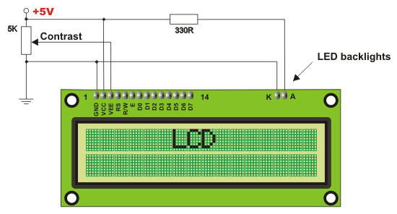
Demonstrated Features
· A small screen LCD display
· A Bluetooth chip to send to the user’s smartphone.
· A smartphone app
· Either replaceable watch batteries or micro-USB rechargeable battery
· Packaged in a sleek design that will comfortably attach to the user’s insulin pen.

Slide 9
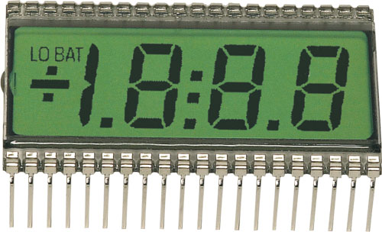
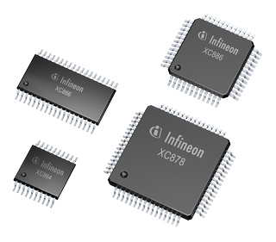
Available Technologies: Microcontroller
Microcontroller:
· Analog to digital converter
· Small, must fit within a confined space
· Low energy
· Serial output
LCD screen
· Low power
· Serial input
· 3 to 4 digit display
· Other dot LCD’s to signal power on, Blutooth connected, etc.

Slide 10
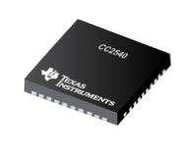

Available Technologies: Bluetooth
SoC: Texas Instruments CC2540
Connectivity IC: Nordic Semiconductors nRF8001

Slide 11
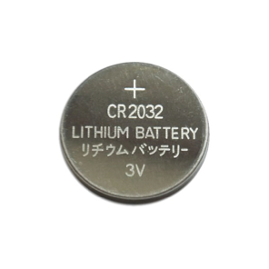
Available Technologies: Battery
CR2032
Button Cell Lithium Battery

Slide 12
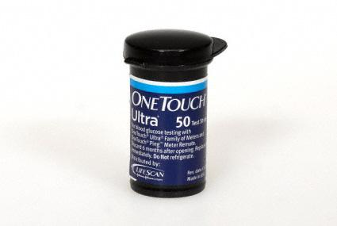
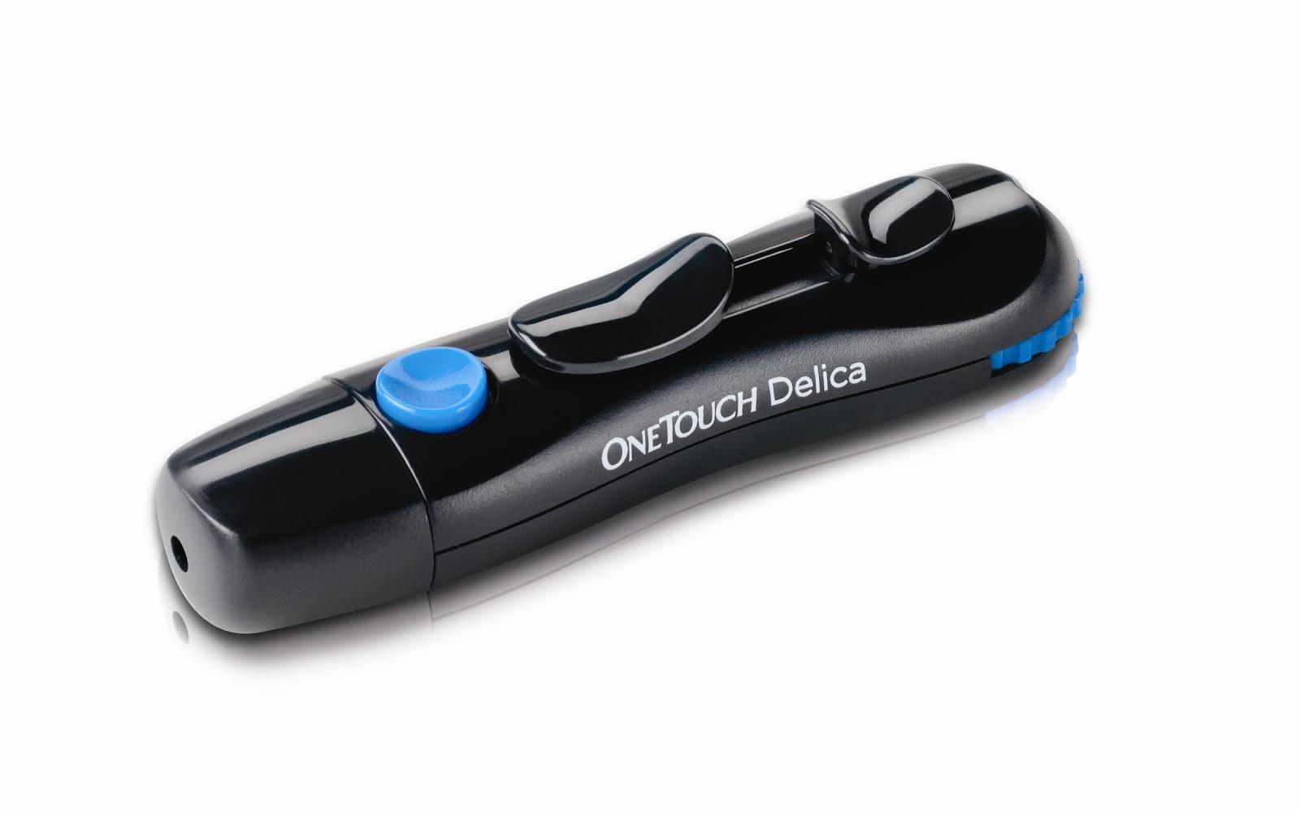
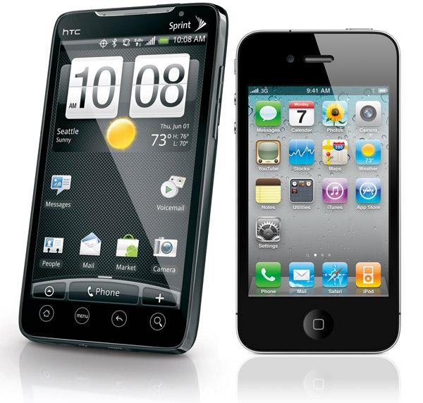
Available Technologies: General
Test Strip Cartridge and test strips: One Touch Ultra
Mechanical lancing devices
iPhone, Android Smartphone

Slide 13
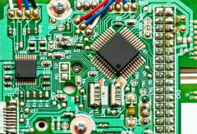
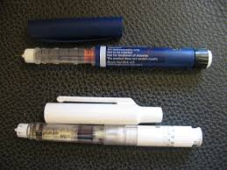
Engineering Content: Glucometer
Size constraint
Circuit board design
Optimize for low power consumption

Slide 14
Engineering Content: Bluetooth
Data Transmission
  Microcontroller -> Bluetooth Radio
  Bluetooth Radio -> Smartphone
Minimize Power Consumption

Slide 15
Engineering Content: Battery
Maximize battery life, minimize size
Deliver appropriate voltage to microcontroller
  Depending on battery selection, voltage may need to be altered in circuit

Slide 16
Engineering Content: Smartphone App
Connect to our glucometer using bluetooth
Store user’s readings
Help interpret blood sugar readings
Allow communication with their physician
Send reminders to check blood sugar

Slide 17
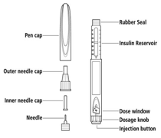
Engineering Content: Device Casing
Combine the lancing device, glucometer, and test strip cartridge into one device
Design it to attach to insulin pens

Slide 18
Conclusions
Difficulties:
must be compact
power consumption and battery life
responsive web app for the majority of Smartphones

Slide 19
Despite the difficulty, we are excited since a product like what we propose is needed and could help a lot of diabetics.

Slide 20
Any Questions?

