Slide 1

Blind Me With
SciEEnce
Caitlin Gruis, E.J. Hinlo, Chris Ravasio
Waking up has never been easier.

Slide 2
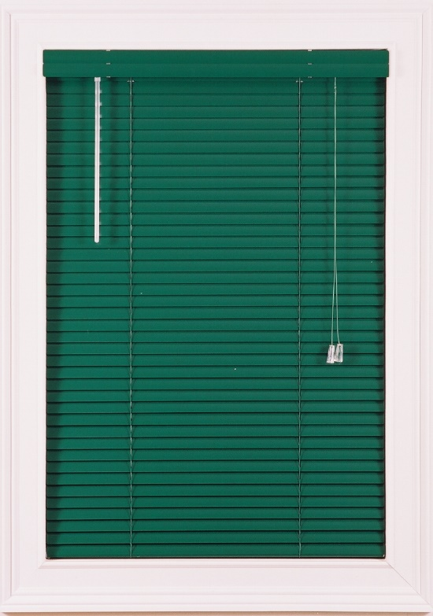

Overview and Introduction
Problem Statement
Proposed Solution
Demonstrated Features
Available Technologies
Engineering Content
+

Slide 3

Problem Description
Waking up is hard
Manually turning blinds is an inconvenience
Figuring out the weather….ugh
Overall, life is hard

Slide 4

Proposed Solution
Using our product makes life EASY!
Makes morning experience more enjoyable
  Takes weather data
  Manages blinds
  Alerts user of weather
Analyze, Automate, Notify

Slide 5

Demonstrated Features
Fully automated blinds that are raised, lowered, opened, or closed based on outdoor and indoor parameters via rotational motor
Weather station with various sensors that gather data (temperature, light, humidity, etc.)
App interface that controls the blinds (manual or scheduled) and notifies the user of the weather
Powered via solar cell with battery backup

Slide 6
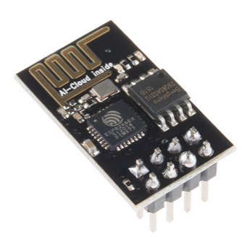



Available Technologies
Wireless interface – to communicate between blinds (motor and weather station) and app
Sensor Technologies – temperature sensor, humidity sensor, light sensor, (wind?, rain?)
Power Source – solar power with back up battery
ESP8266
TMP36
HIH-4030
Photocell

Slide 7

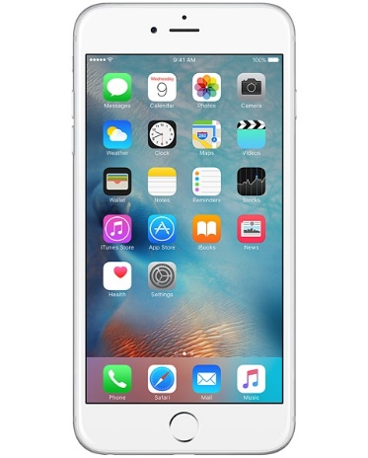

Available Technologies
Servo
Servo motor – to rotate the blinds
Microcontroller – TBD exact specs
iOS application – programmed in Xcode
iPhone App
Xcode

Slide 8
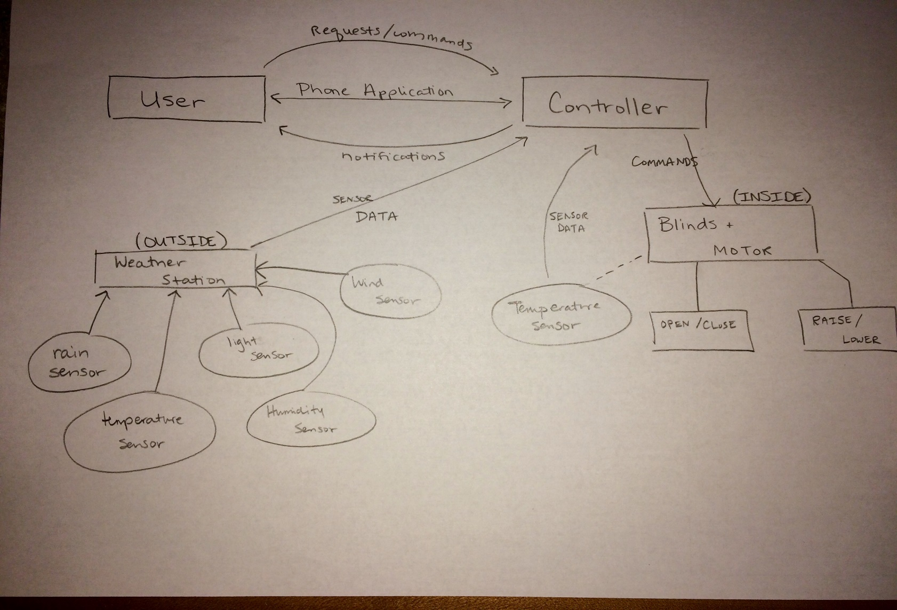
Engineering Content (Diagram)

Slide 9

Engineering Content (Steps)
Customize the controller
Install motor to blinds
Connect blind/motor system to controller
Calibrate sensors
Code functions and develop controller logic/flow
Develop app
Interface each block with each other

Slide 10

Conclusion
Waking Up Naturally to the Sun
Automated Blinds + Weather Station + App = WOW
Features – WHAT ARE THOOOSE?
Available Technologies – Picking and Choosing
How are we going to do this?

Slide 11



Any Questions?

